Slide 1
Boom Containment and Protection
CGPRT(W) : Ensuring Clean Seas and Coasts in Western Region ……

Slide 2
Objective
To understand the operational aspects for containment and protection boom deployment including support equipment and anchoring techniques.
CGPRT(W) : Ensuring Clean Seas and Coasts in Western Region ……

Slide 3
Outline
Boom characteristics
Boom types
Boom deployment
Boom anchoring
Support equipment
CGPRT(W) : Ensuring Clean Seas and Coasts in Western Region ……

Slide 4
Boom
Physical barrier to:
Stop spreading
Concentrate oil
Protect sensitive resources
Many types
CGPRT(W) : Ensuring Clean Seas and Coasts in Western Region ……

Slide 5
Boom Characteristics
CGPRT(W) : Ensuring Clean Seas and Coasts in Western Region ……

Slide 6
Key Characteristics of Boom
Size
Freeboard
Draft
Buoyancy ratio
Strength
Ease of deployment
CGPRT(W) : Ensuring Clean Seas and Coasts in Western Region ……

Slide 7
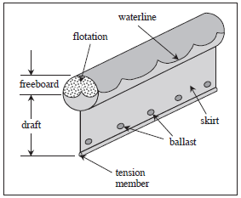
Key Components of Boom
CGPRT(W) : Ensuring Clean Seas and Coasts in Western Region ……

Slide 8
Boom Types
CGPRT(W) : Ensuring Clean Seas and Coasts in Western Region ……

Slide 9
Boom Types
Curtain boom
Solid floatation
Self inflating
Inflatable
Shore seal boom
CGPRT(W) : Ensuring Clean Seas and Coasts in Western Region ……

Slide 10
Curtain Boom
Flotation member filled with air, inert gas, solid foam or granulated foam.
Flexible skirt which can move independently of flotation member.
Buoyancy ratio between 5:1 – 20:1.
Air filled booms: easy to clean but slower to deploy than solid booms.
Storage: small for air filled; large for solid foam filled booms.
CGPRT(W) : Ensuring Clean Seas and Coasts in Western Region ……

Slide 11
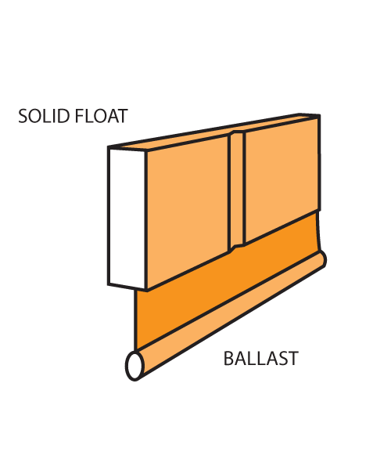
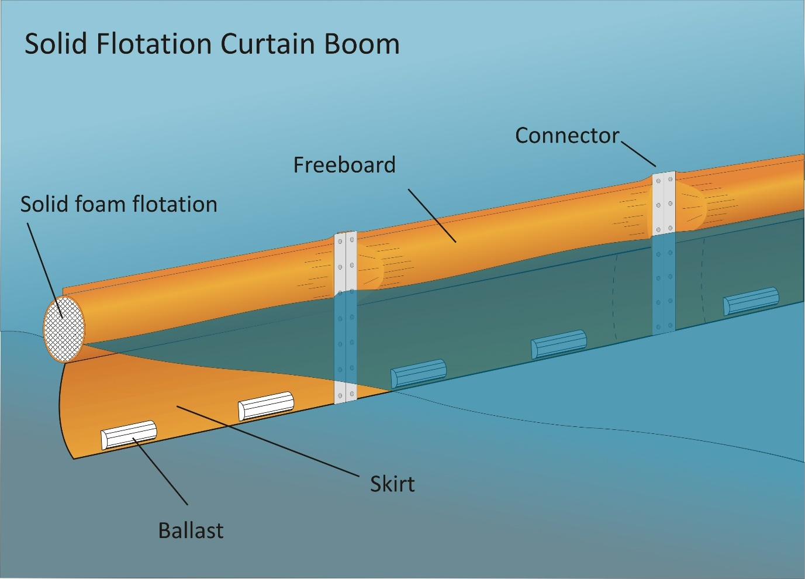
Solid Flotation Boom
CGPRT(W) : Ensuring Clean Seas and Coasts in Western Region ……

Slide 12
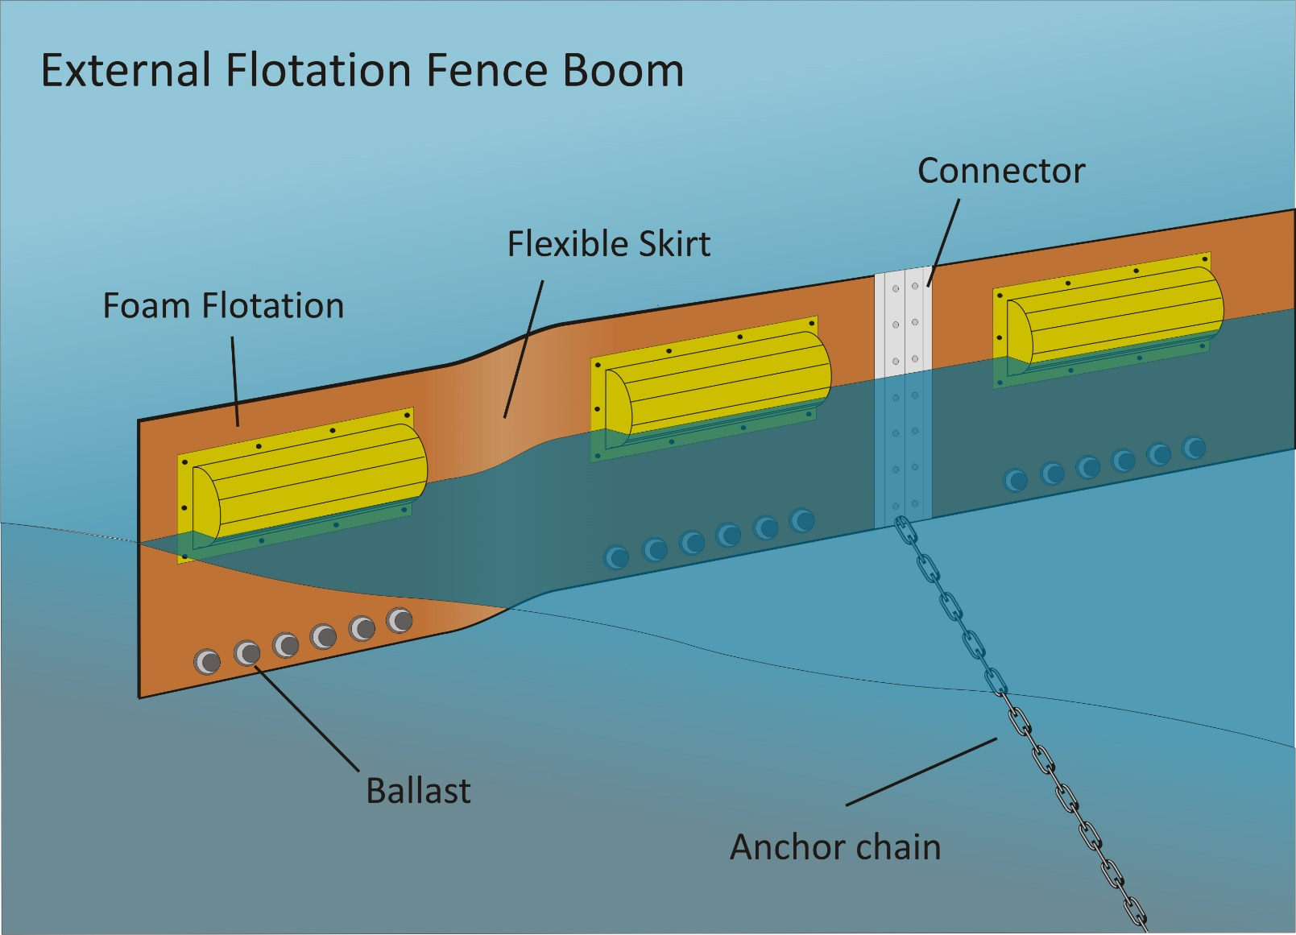
Solid Flotation Fence Boom
CGPRT(W) : Ensuring Clean Seas and Coasts in Western Region ……

Slide 13
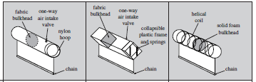
Self Inflating Boom
CGPRT(W) : Ensuring Clean Seas and Coasts in Western Region ……

Slide 14
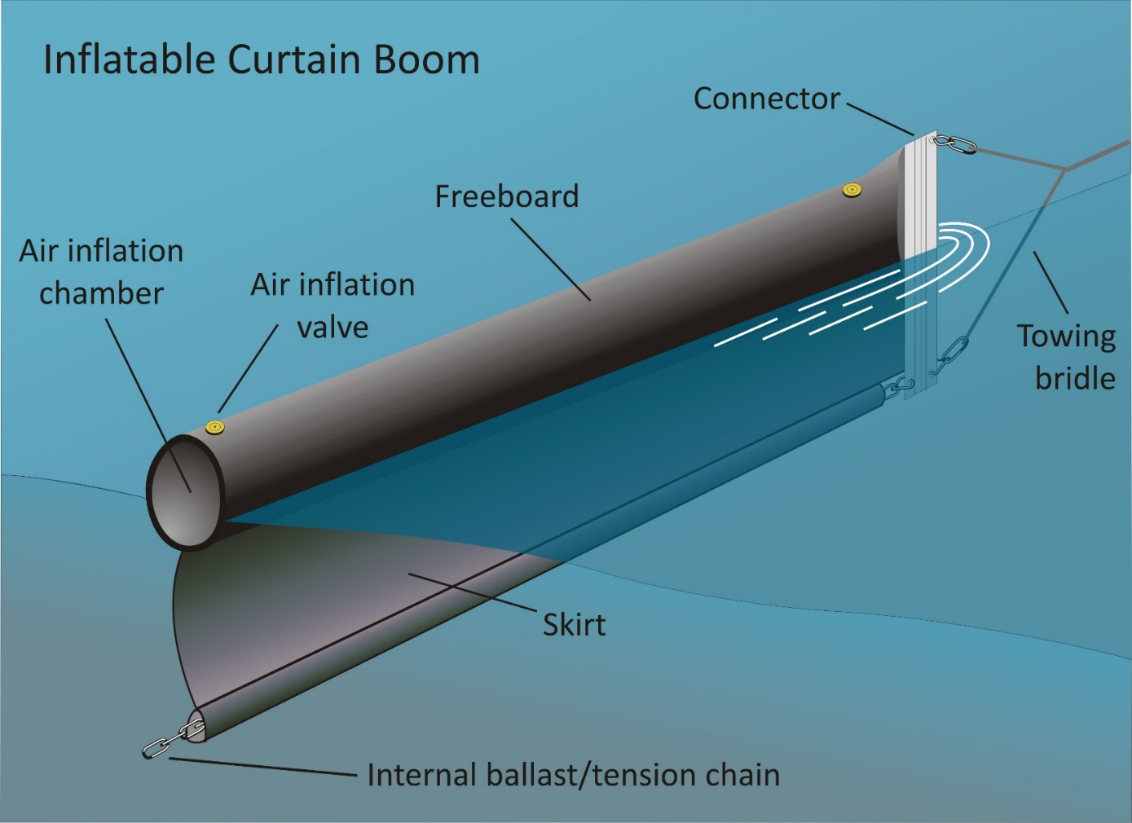
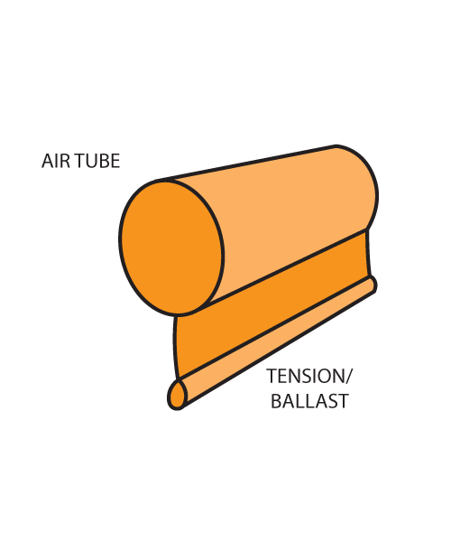
Inflatable Boom
CGPRT(W) : Ensuring Clean Seas and Coasts in Western Region ……

Slide 15
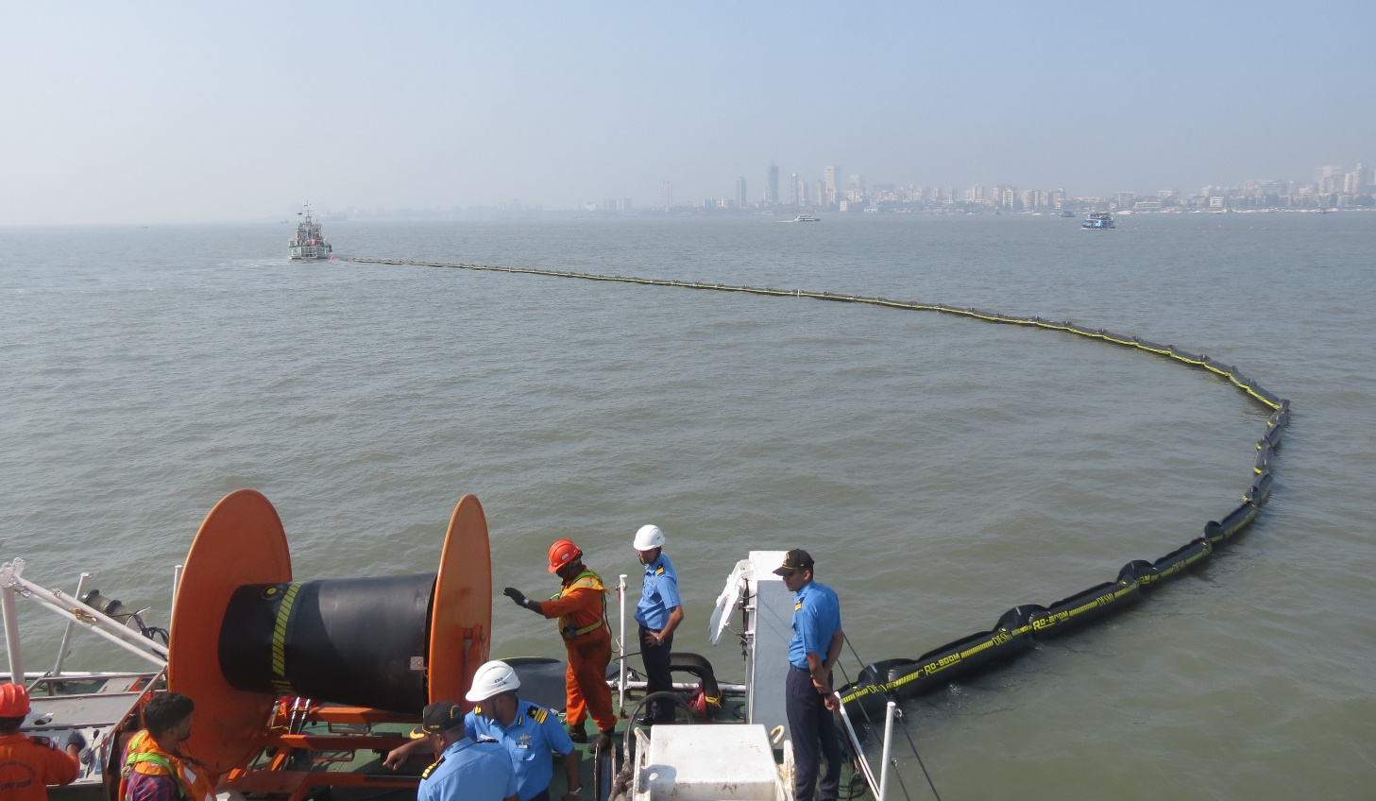
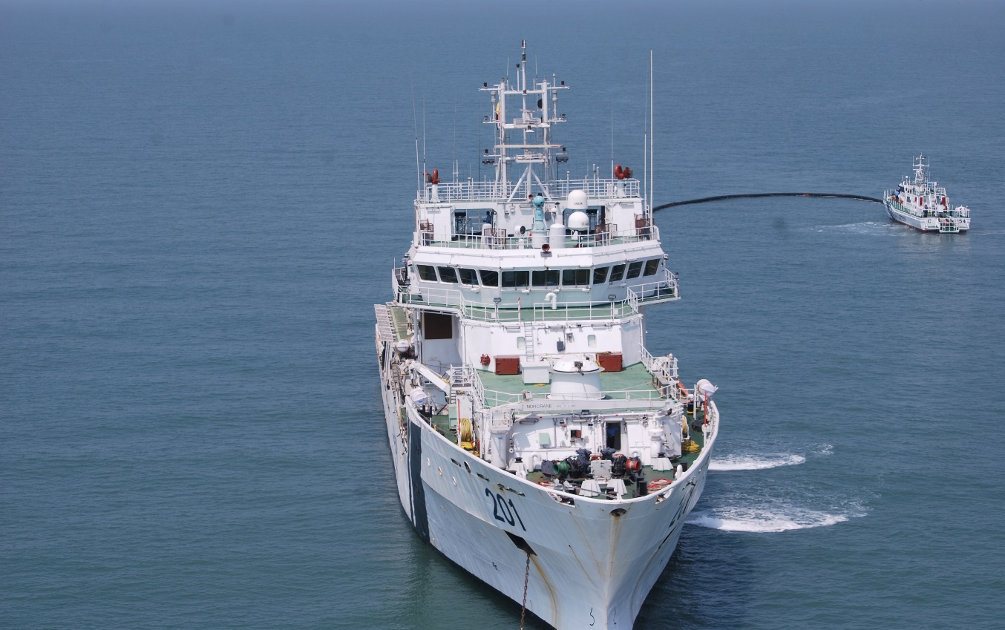
Inflatable Boom
CGPRT(W) : Ensuring Clean Seas and Coasts in Western Region ……

Slide 16
Shore Seal Boom
Specially designed to keep the oil in the inter-tidal zone.
Unique – cannot be replaced by other boom types.
Must be handled with care to prevent tearing the bottom.
Can be connected to floating containment booms.
Ensure boom in position before commencing to fill ballast chambers.
Ensure extends above the high water mark.
CGPRT(W) : Ensuring Clean Seas and Coasts in Western Region ……

Slide 17
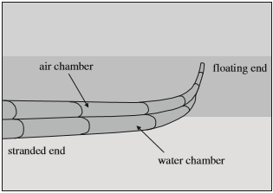
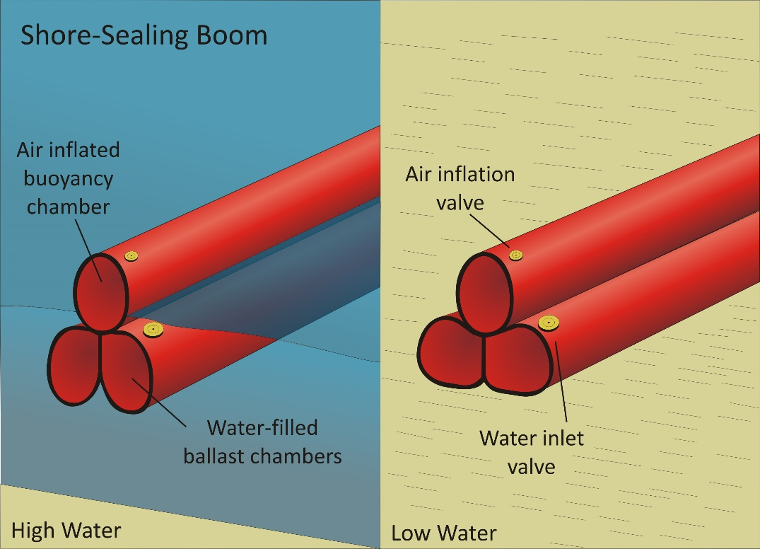
Shore Seal Boom
CGPRT(W) : Ensuring Clean Seas and Coasts in Western Region ……

Slide 18
Shore Seal Boom – Low Water
Air
Water
Low Tide
CGPRT(W) : Ensuring Clean Seas and Coasts in Western Region ……

Slide 19
Shore Seal Boom – High Water
Air
Water
High tide
CGPRT(W) : Ensuring Clean Seas and Coasts in Western Region ……

Slide 20
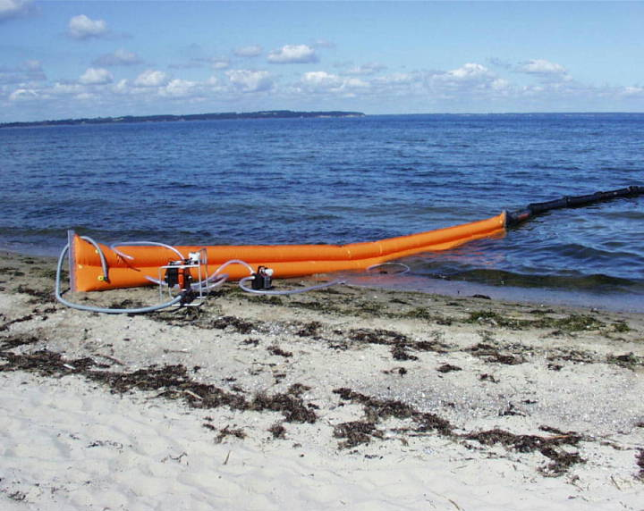
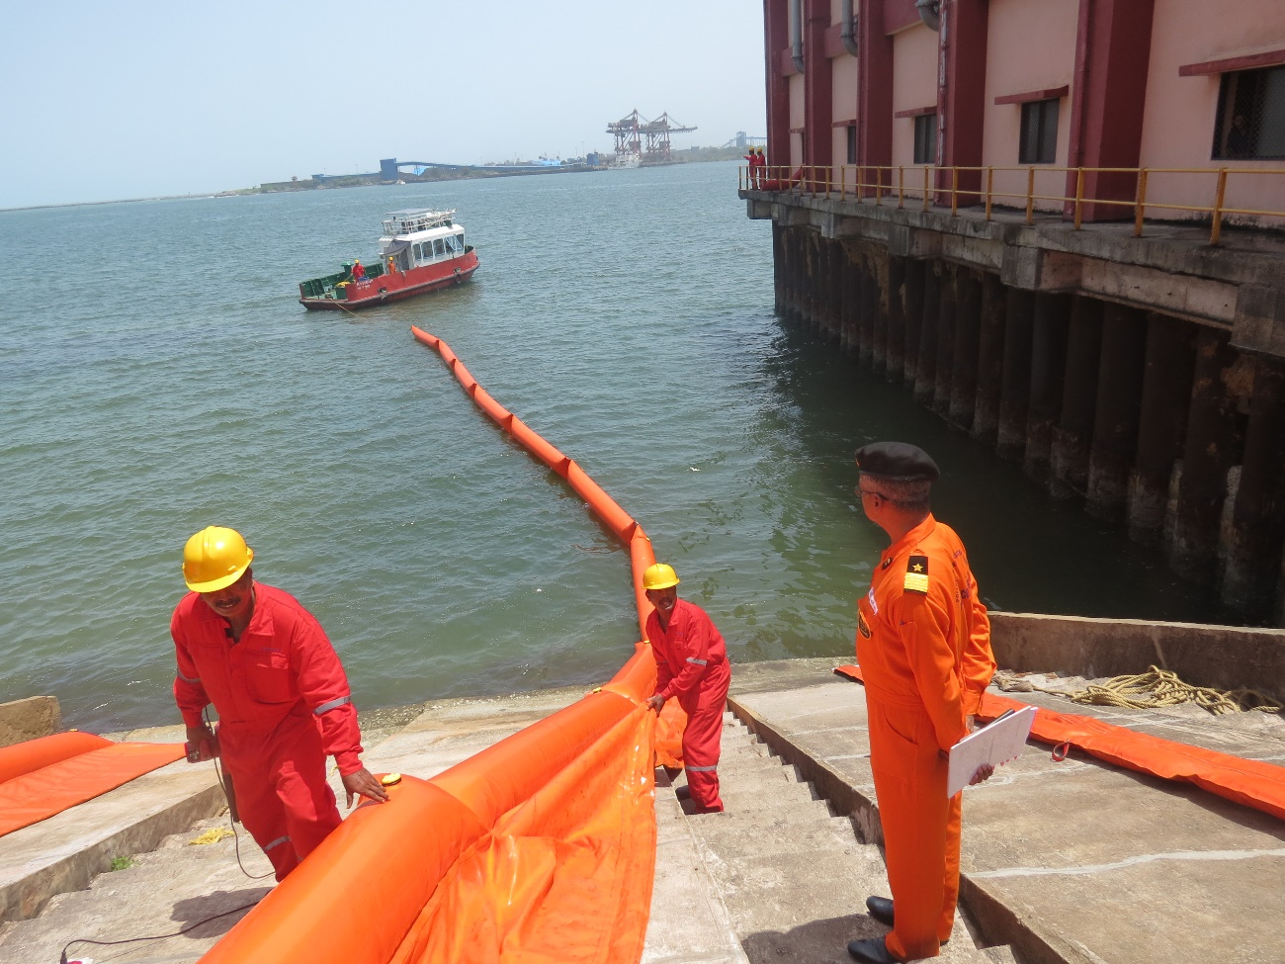
Shore Seal Boom
CGPRT(W) : Ensuring Clean Seas and Coasts in Western Region ……

Slide 21
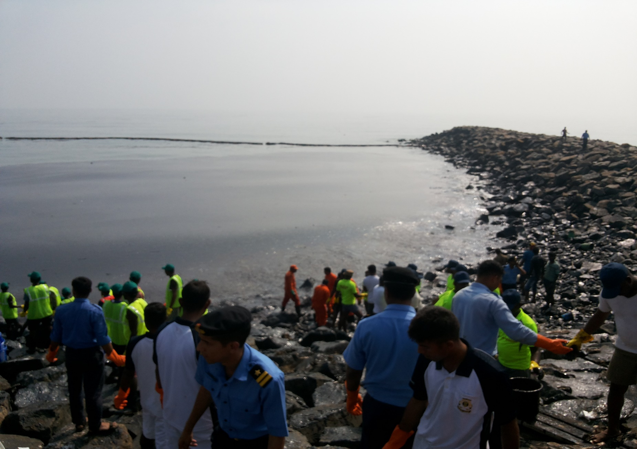
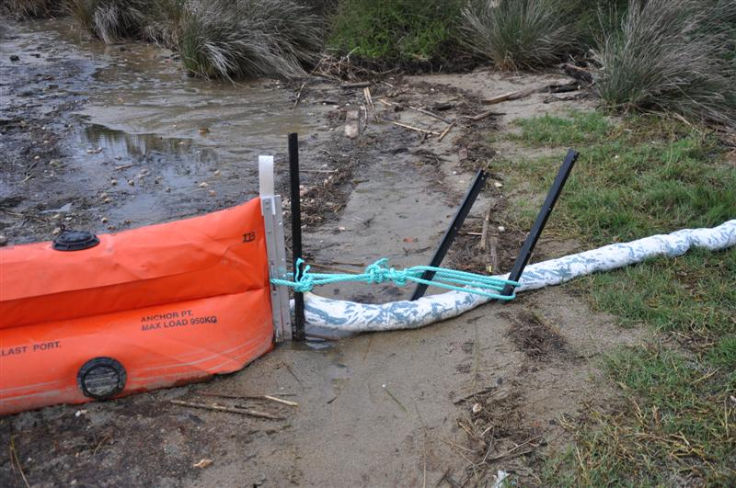
Shore Seal Boom
CGPRT(W) : Ensuring Clean Seas and Coasts in Western Region ……

Slide 22
Sorbent Boom
Sorbent material in cylindrical shape
Deployed like a boom
May have clips that allow sections to be joined together
May have skirts
CGPRT(W) : Ensuring Clean Seas and Coasts in Western Region ……

Slide 23
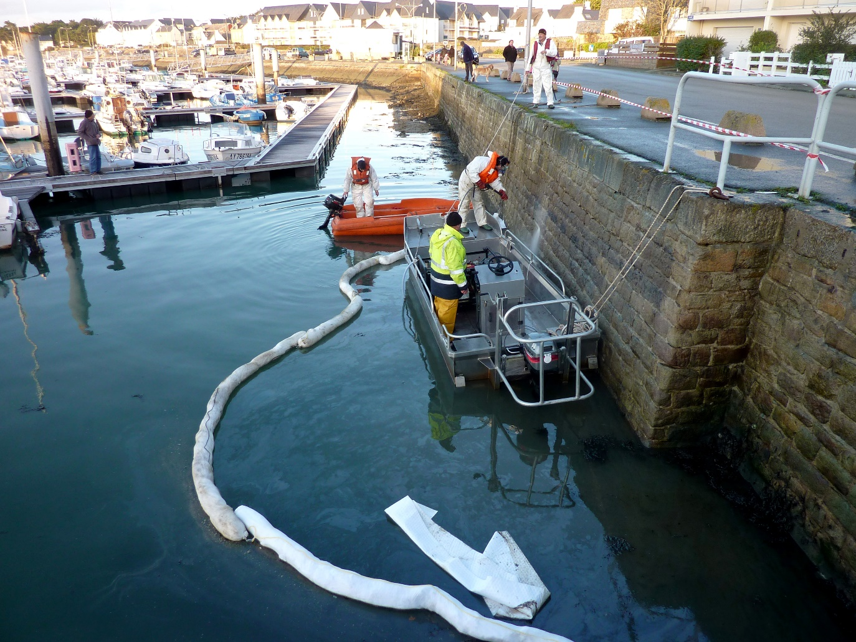
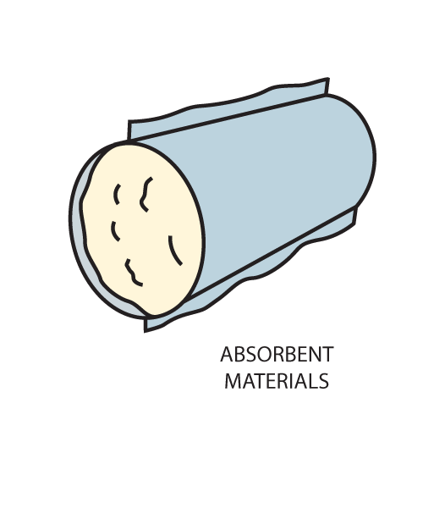
Sorbent Boom
CGPRT(W) : Ensuring Clean Seas and Coasts in Western Region ……

Slide 24
Boom Selection
Boom selection based on
Environmental conditions
Performance characteristics
Convenience characteristics
CGPRT(W) : Ensuring Clean Seas and Coasts in Western Region ……

Slide 25
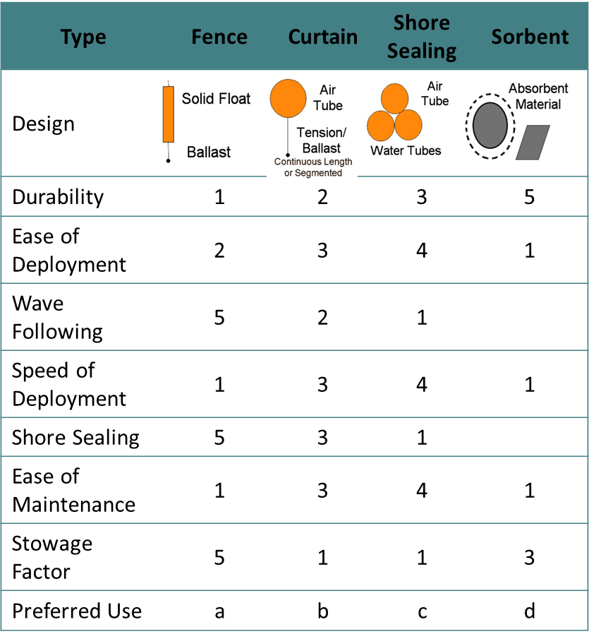
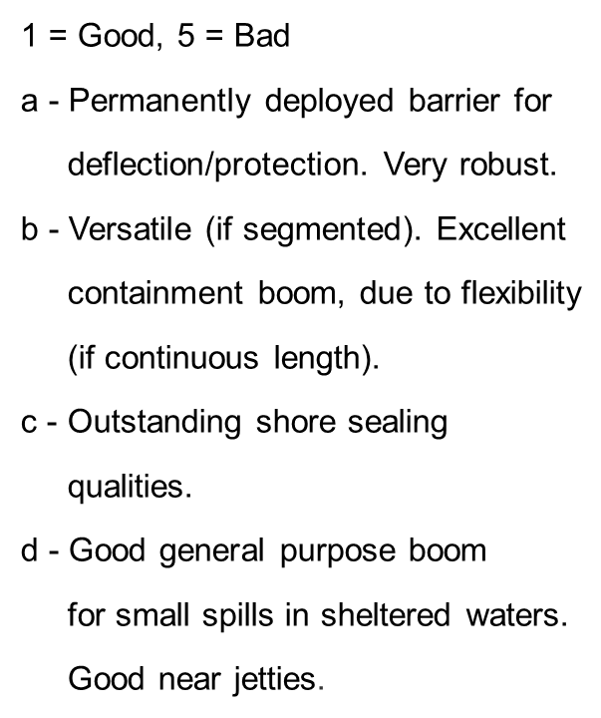
Boom Selection
CGPRT(W) : Ensuring Clean Seas and Coasts in Western Region ……

Slide 26
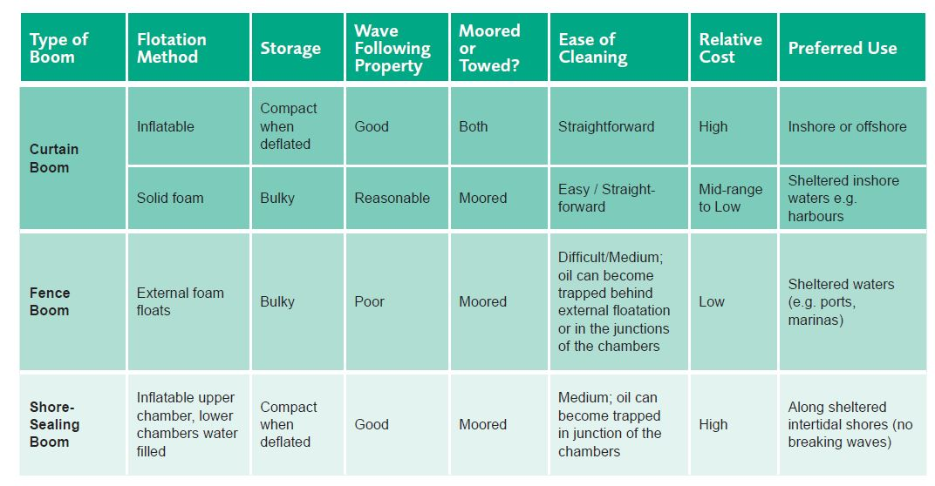
Boom Selection
CGPRT(W) : Ensuring Clean Seas and Coasts in Western Region ……

Slide 27
Limitations of Boom
Deployment takes time during which oil spreads
Fail in strong currents and winds
Easily damaged
Require extensive logistical support
Require regular maintenance
Mooring and anchoring problems
Close-off water areas, hindering boat movement
CGPRT(W) : Ensuring Clean Seas and Coasts in Western Region ……

Slide 28
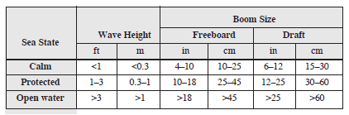
Sea State and Boom Size
CGPRT(W) : Ensuring Clean Seas and Coasts in Western Region ……

Slide 29
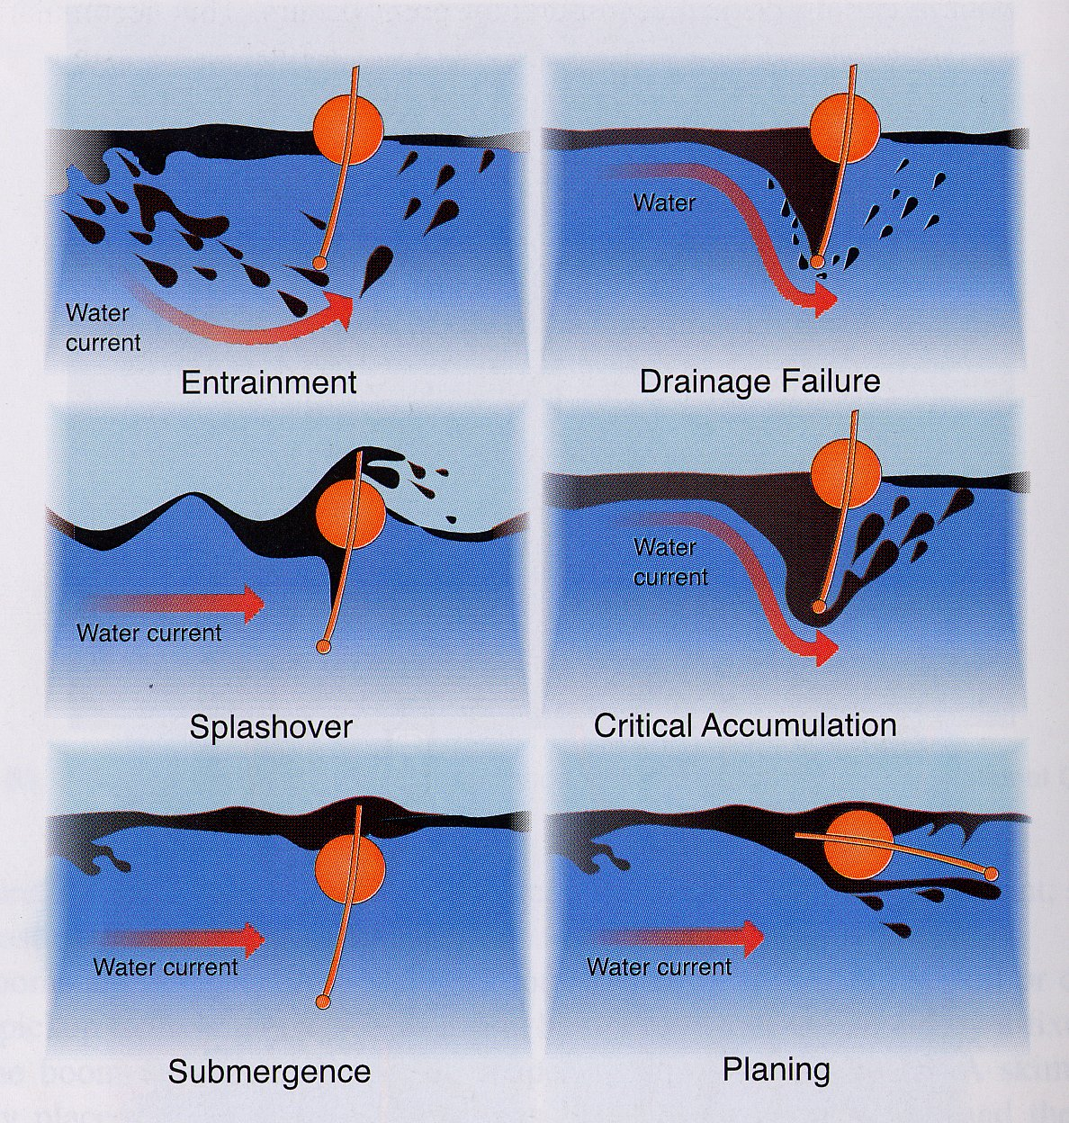
Boom Failure
Source: Fingas, “The Basics of Oil Spill Clean-up” 2001
CGPRT(W) : Ensuring Clean Seas and Coasts in Western Region ……

Slide 30
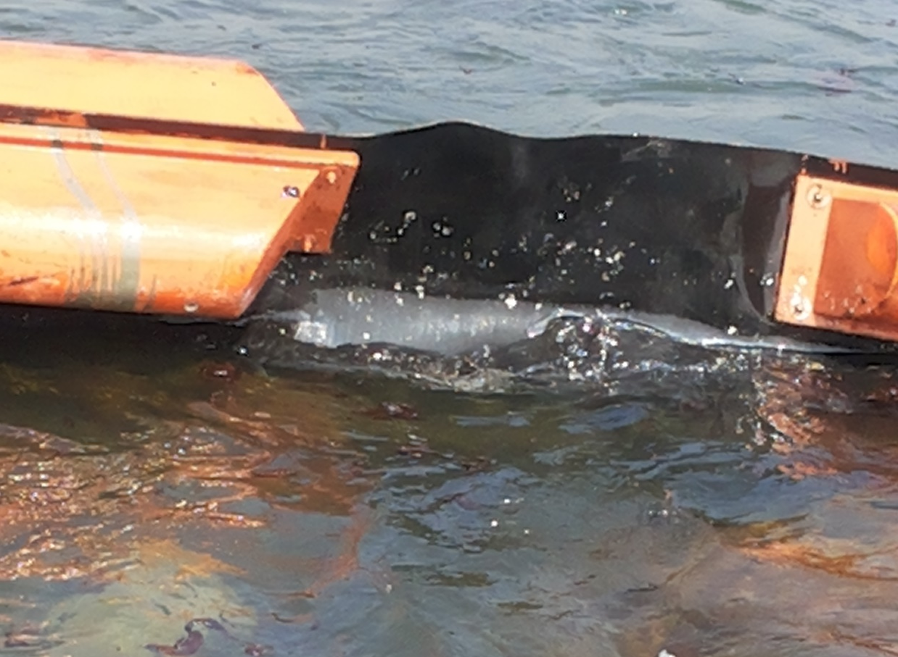
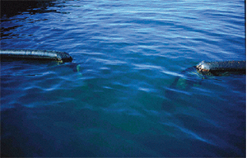
Boom Failure
CGPRT(W) : Ensuring Clean Seas and Coasts in Western Region ……

Slide 31
Boom Deployment
CGPRT(W) : Ensuring Clean Seas and Coasts in Western Region ……

Slide 32
Boom Deployment from Vessel
Deployment operation steps:
Secure equipment to the deck - boom reels, power packs, or other auxiliary equipment as required.
Attach towing equipment to outboard section of boom – towing bridle/towing paravane, towline.
Attach a float/buoy to the end of the towline for easier retrieval.
Pay out boom reel, deploying the boom sections over the stern.
Essential to secure equipment properly on board vessel before operation.
CGPRT(W) : Ensuring Clean Seas and Coasts in Western Region ……

Slide 33
Boom Deployment from Vessel
Deployment operation steps:
For inflatable boom each section is inflated on the deck as boom is paid out.
When inflating boom sections, ensure boom is secure with a safety chain/cable before workers insert blowers to fill valves for safety.
Vessel should deploy into the wind/current allowing boom to stream astern without wrapping around stern or fouling the propellers.
Connect the boom to the auxiliary vessel – the float/buoy on towline can be used for easier retrieval.
CGPRT(W) : Ensuring Clean Seas and Coasts in Western Region ……

Slide 34
Boom Deployment from Vessel
Boom reel operator must use signaller and have a clear line of sight.
Be aware of pinch points.
Be aware of working near the stern of the vessel.
Understand man overboard procedures.
CGPRT(W) : Ensuring Clean Seas and Coasts in Western Region ……

Slide 35
Boom Deployment from Vessel
Safest deployment uses a main vessel alone − reduces risk.
If two vessels are conducting boom operations together, communication between the two vessels is essential for successful and safe operations.
Vessels must coordinate speed and power.
CGPRT(W) : Ensuring Clean Seas and Coasts in Western Region ……

Slide 36
Boom Deployment from Vessel
The steps for boom deployment are reversed.
Boom is spooled onto reel as it is recovered.
Inflatable boom is deflated as each section comes on board ensuring a safety chain/cable is attached before workers insert hose into valve.
Be aware of pinch points.
CGPRT(W) : Ensuring Clean Seas and Coasts in Western Region ……

Slide 37
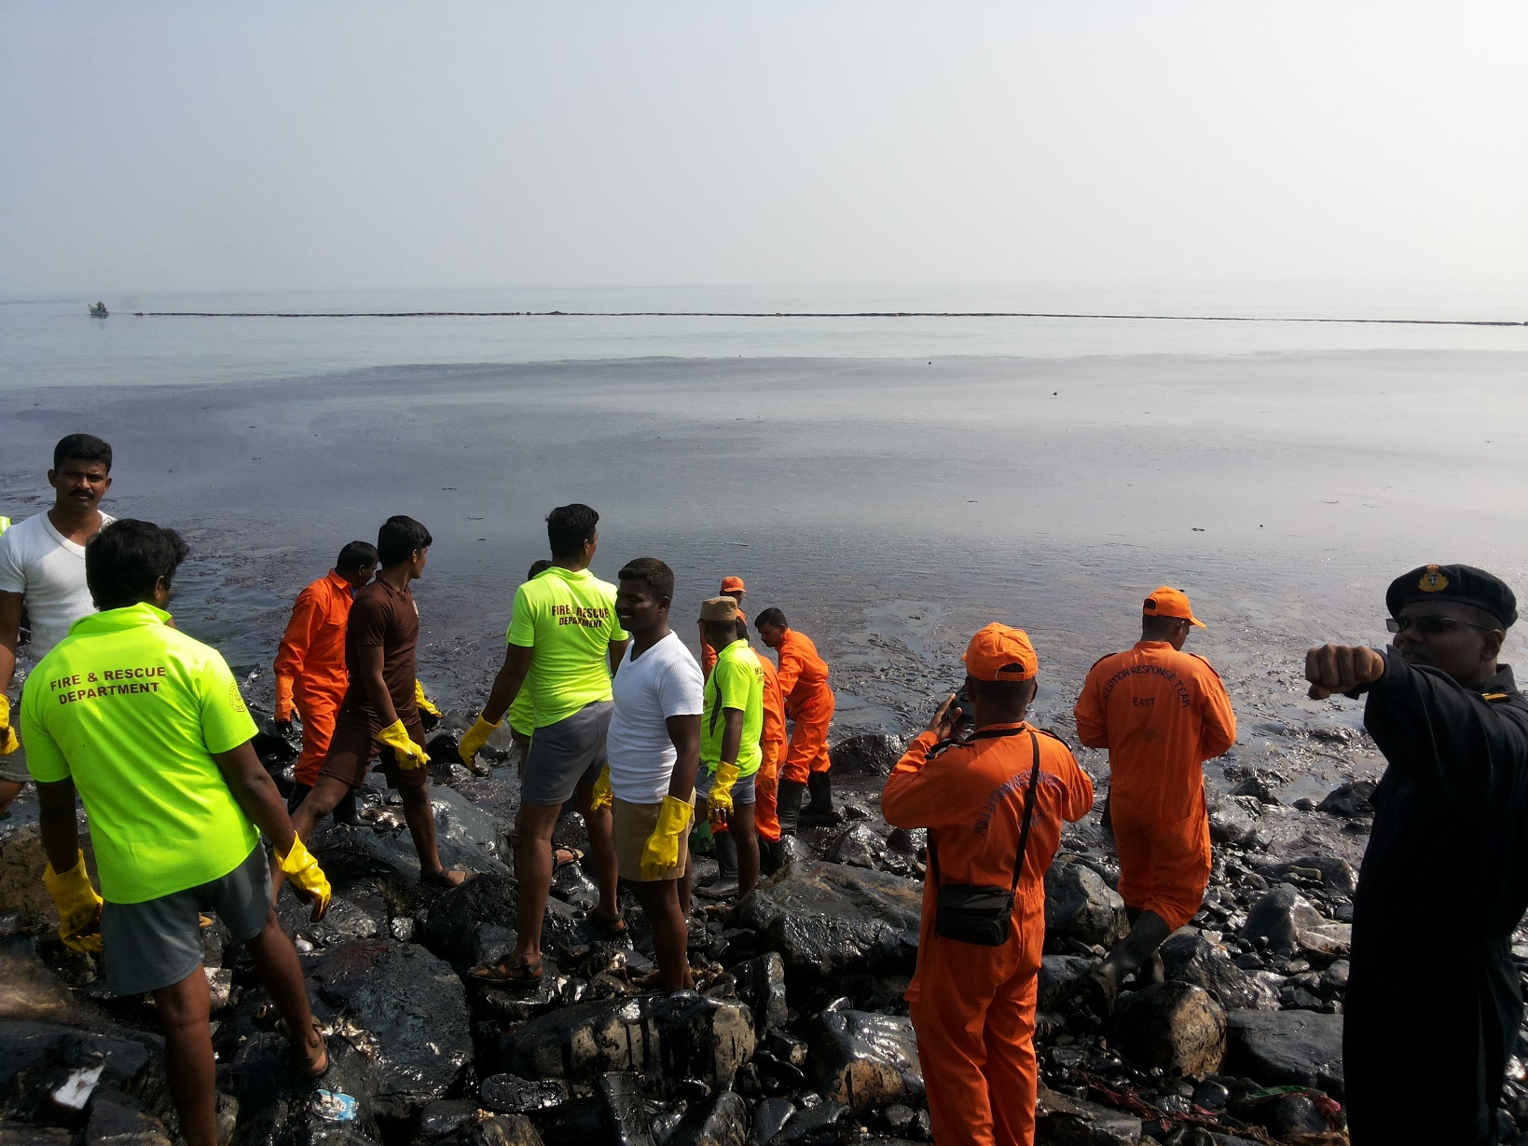
Boom Deployment
CGPRT(W) : Ensuring Clean Seas and Coasts in Western Region ……

Slide 38
Boom Deployment from Shoreline
Deployment operation steps:
Secure equipment − boom reels, power packs, or other auxiliary equipment as required.
Attach towing equipment to outboard section of boom – towing bridle/towing paravane, towline if boom is being pulled out by a vessel.
Clear shoreline of debris that can damage the boom/use chafing mats.
Pay out boom reel/boom by hand.
Essential to secure equipment properly before operation whether beach or man-made structure.
CGPRT(W) : Ensuring Clean Seas and Coasts in Western Region ……

Slide 39
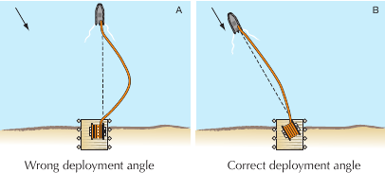
Boom Deployment Approach
Source: National Spill Control School
CGPRT(W) : Ensuring Clean Seas and Coasts in Western Region ……

Slide 40
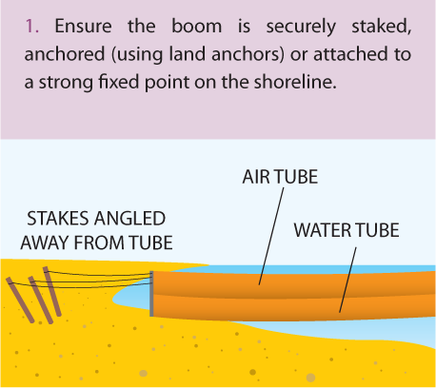
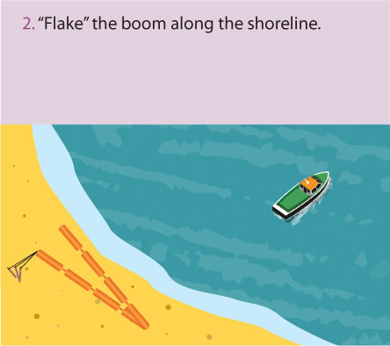
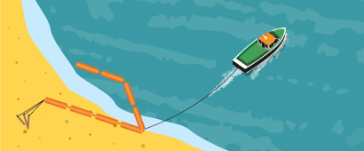
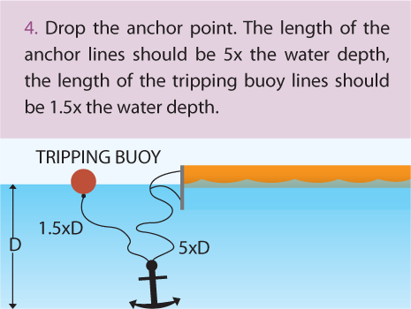
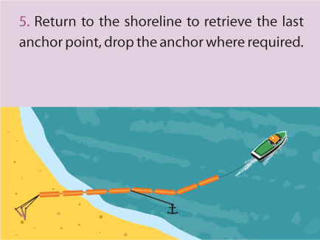
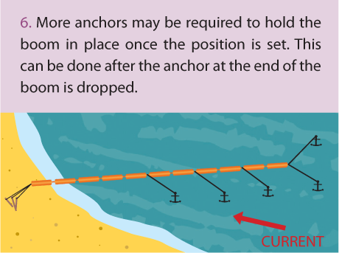
Boom Deployment Approach
3
CGPRT(W) : Ensuring Clean Seas and Coasts in Western Region ……

Slide 41
Boom Recovery from a Shoreline
The steps for boom deployment are reversed.
Boom is spooled onto reel as it is recovered.
Ensure boom isn’t being damaged by dragging over debris/rough shorelines.
Be aware of pinch points.
CGPRT(W) : Ensuring Clean Seas and Coasts in Western Region ……

Slide 42
Standard Boom Configurations
On-water containment and recovery
Single vessel
Two vessels
J-configuration
U-configuration
Three vessels
CGPRT(W) : Ensuring Clean Seas and Coasts in Western Region ……

Slide 43
Vessel Operations
Two main categories:
Purpose built or adapted response vessels
Vessels of opportunity (VOO).
All vessels must be fit for purpose and approved by the relevant authorities (maritime administration, etc.).
VOO may be fitted with response equipment and trained personnel.
Local VOOs will have local knowledge.
CGPRT(W) : Ensuring Clean Seas and Coasts in Western Region ……

Slide 44
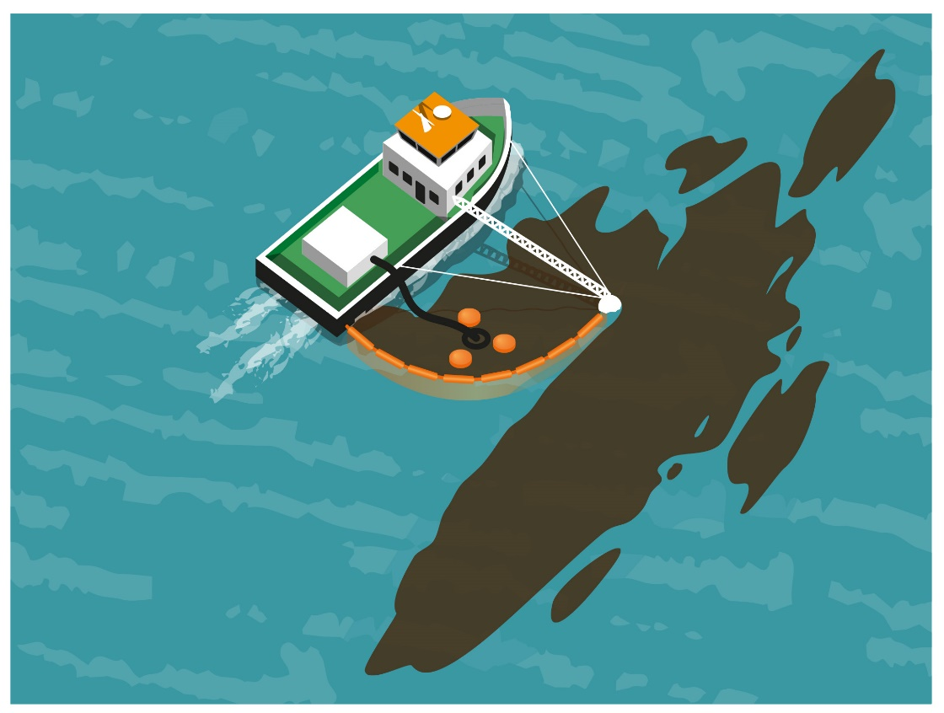
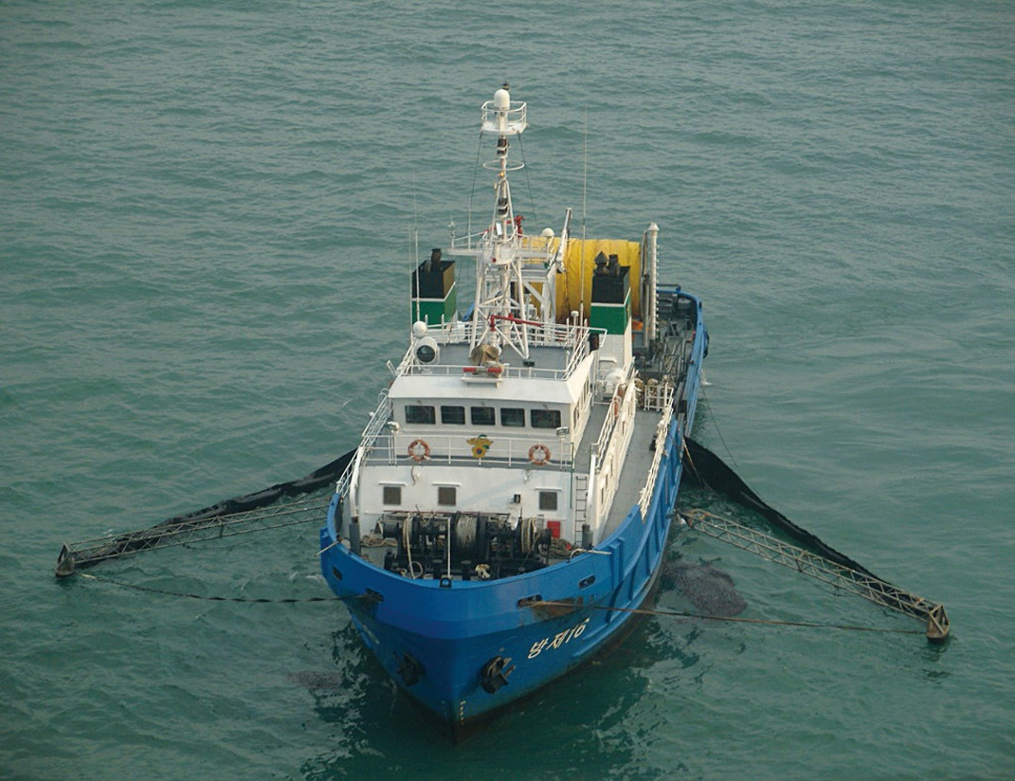
Single Vessel Configurations
CGPRT(W) : Ensuring Clean Seas and Coasts in Western Region ……

Slide 45
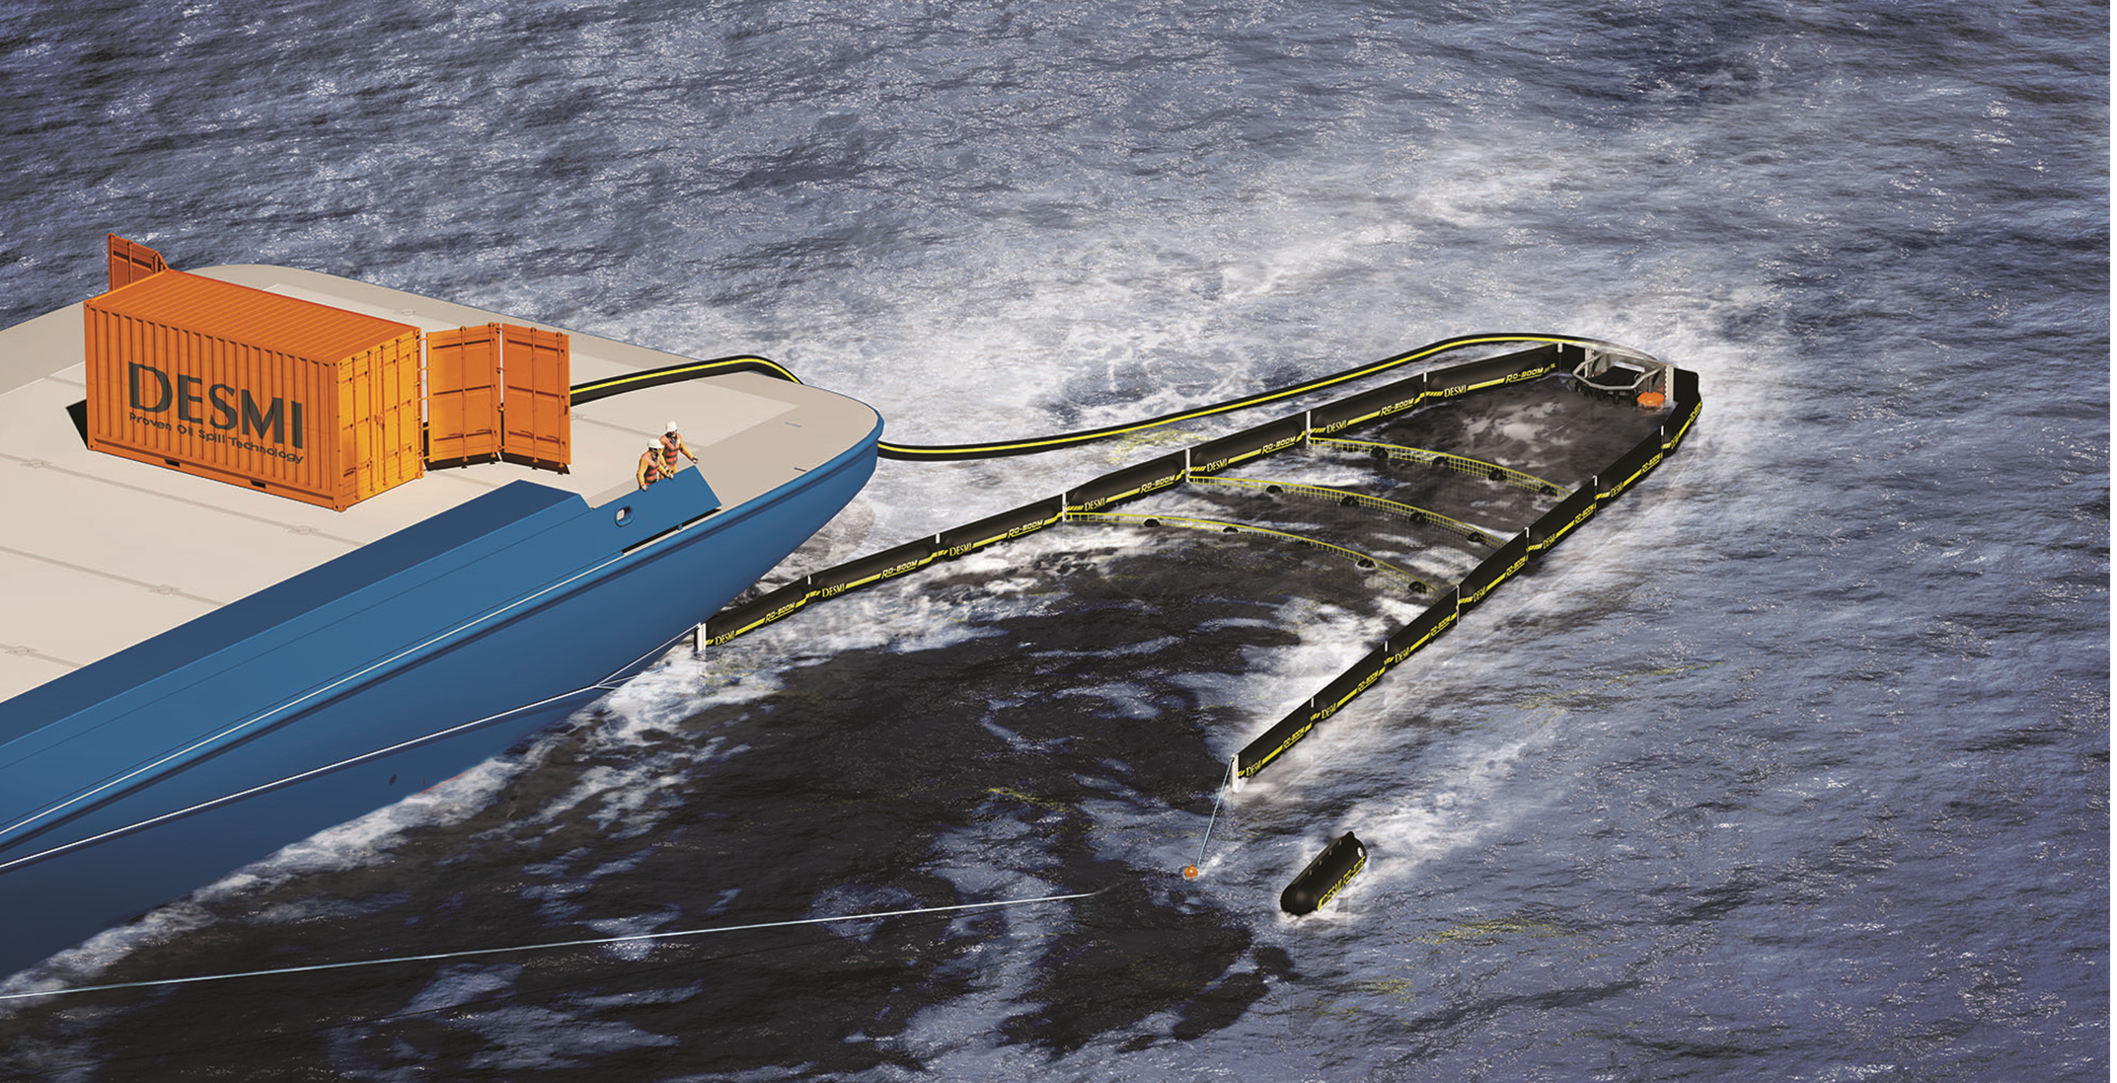
Single Vessel Configurations
CGPRT(W) : Ensuring Clean Seas and Coasts in Western Region ……

Slide 46
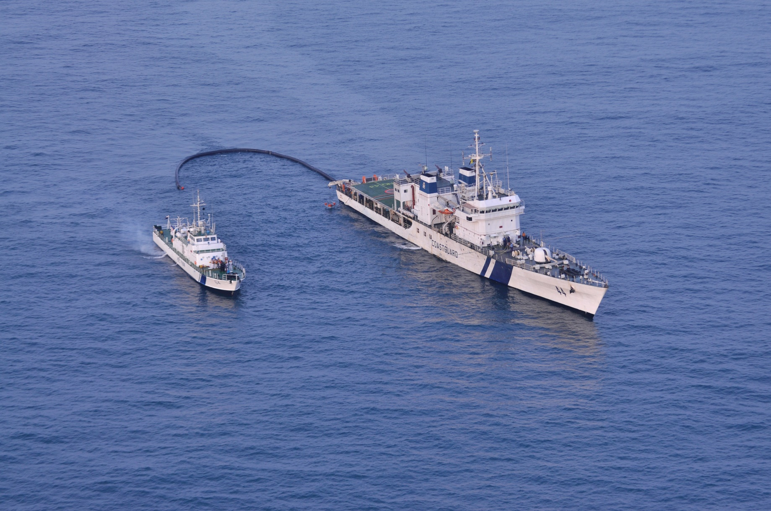
Two Vessel - J-Configuration
CGPRT(W) : Ensuring Clean Seas and Coasts in Western Region ……

Slide 47
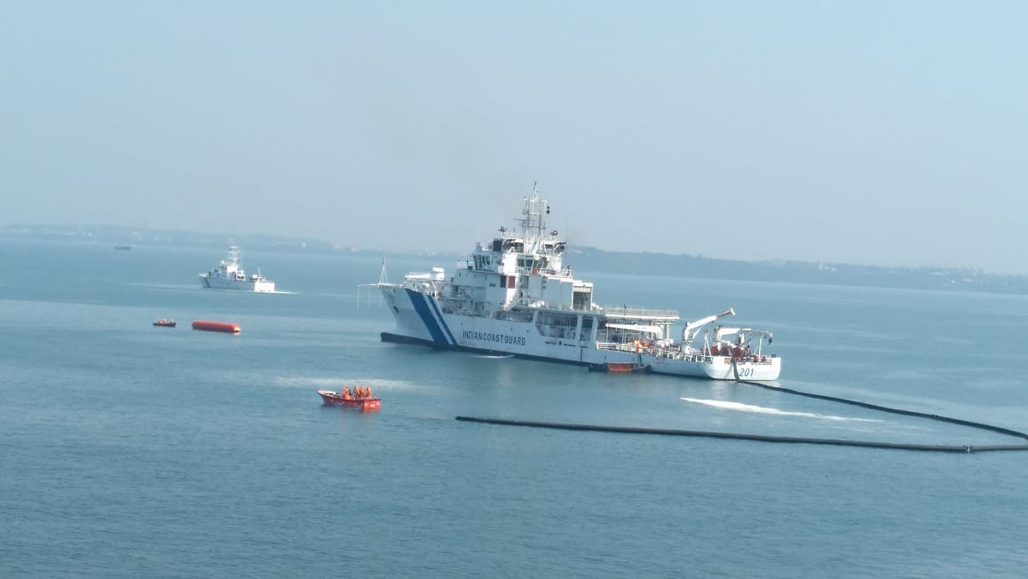
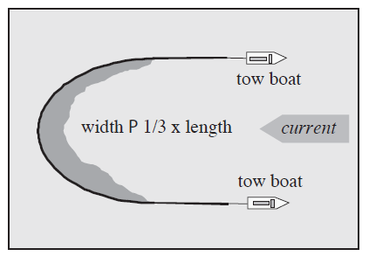
Two Vessel - U-Configuration
CGPRT(W) : Ensuring Clean Seas and Coasts in Western Region ……

Slide 48
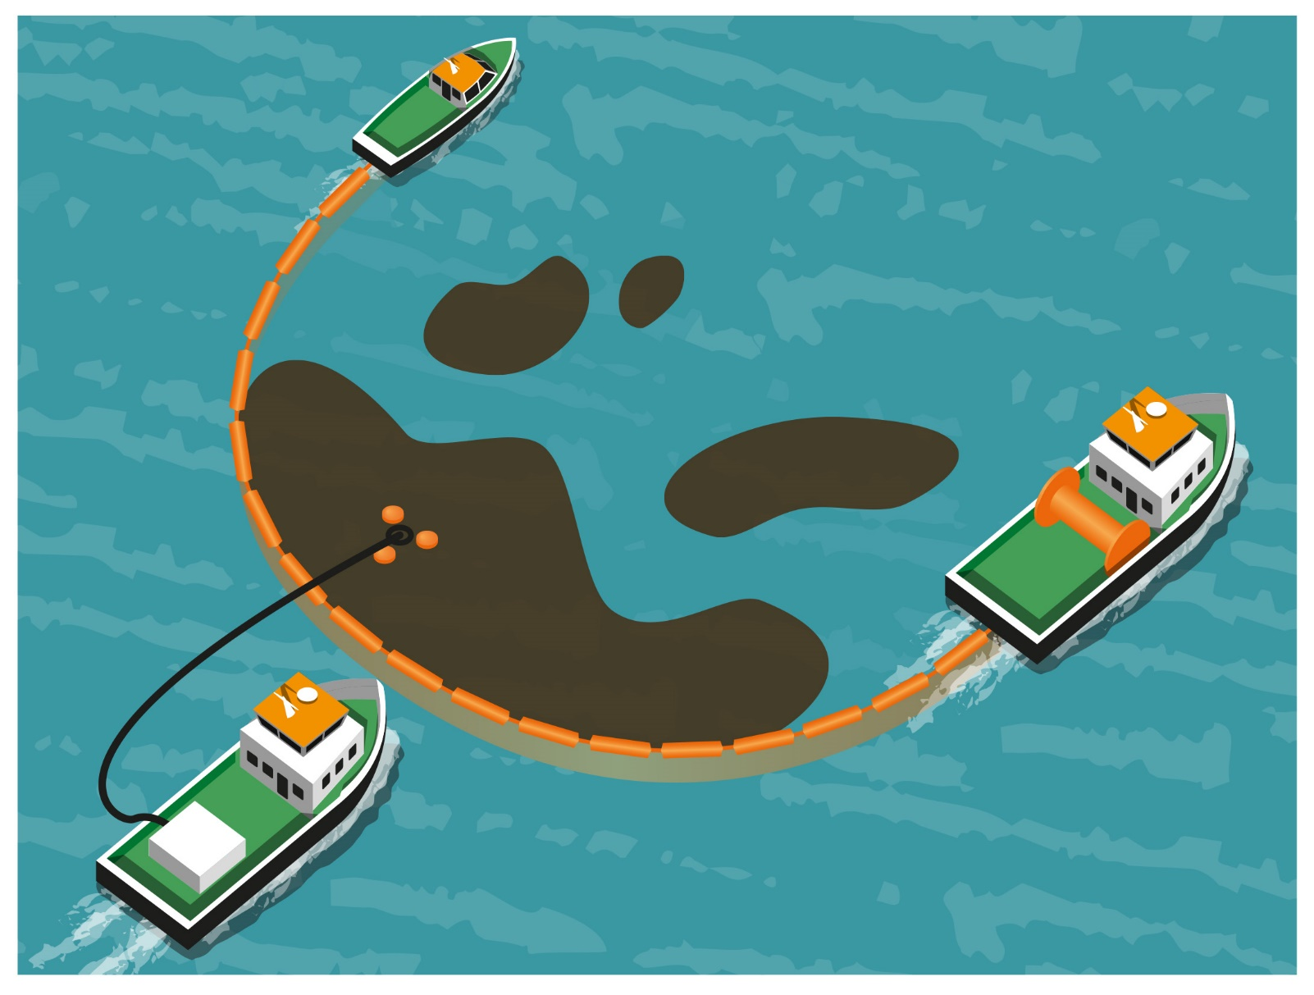
Three Vessel - U-Configuration
CGPRT(W) : Ensuring Clean Seas and Coasts in Western Region ……

Slide 49
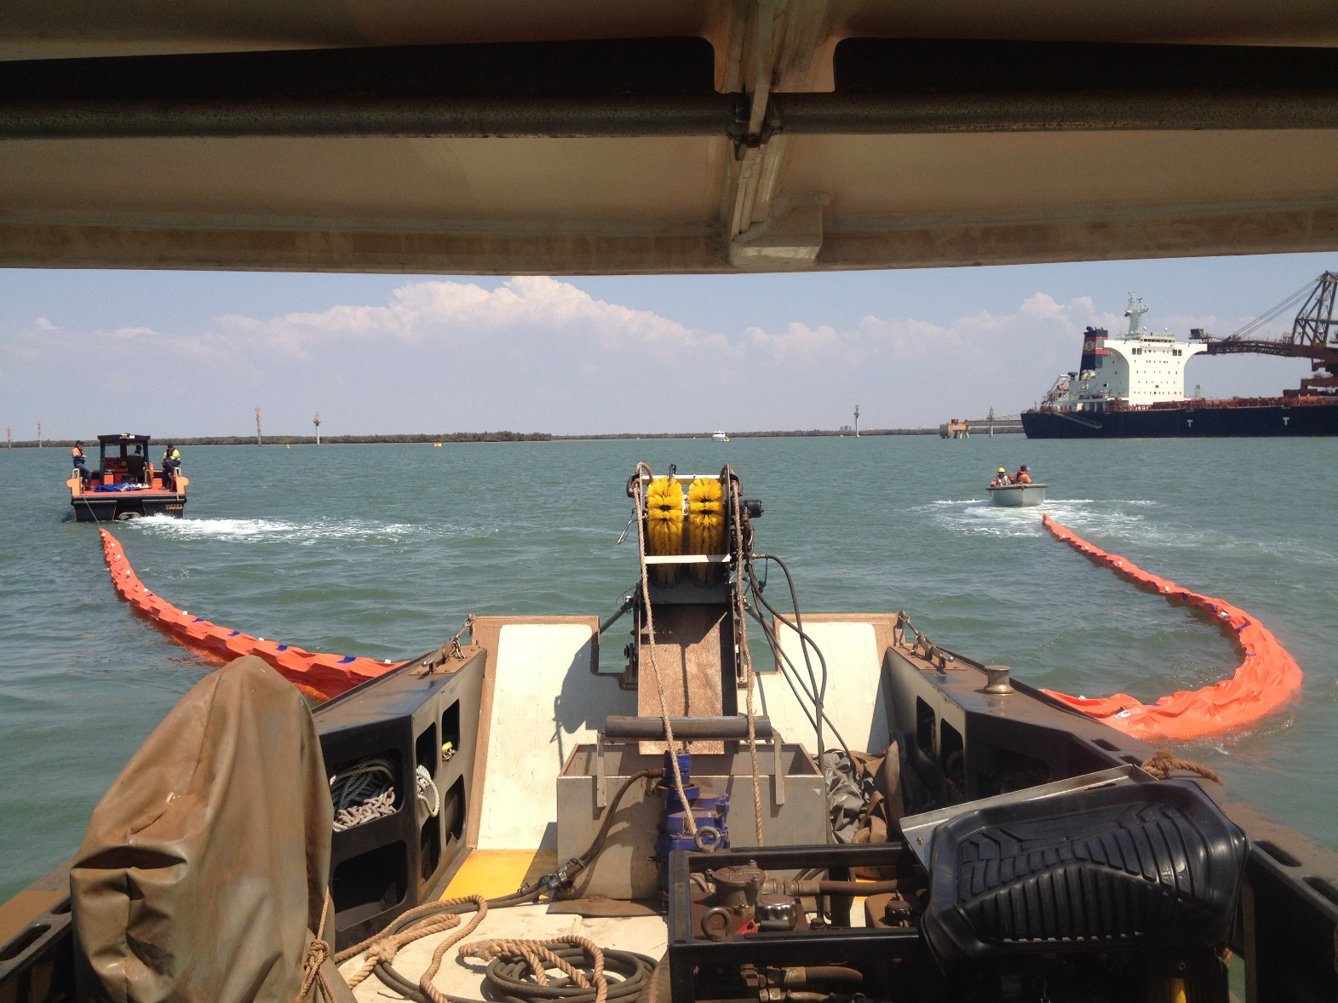
Three Vessel - U-Configuration
CGPRT(W) : Ensuring Clean Seas and Coasts in Western Region ……

Slide 50
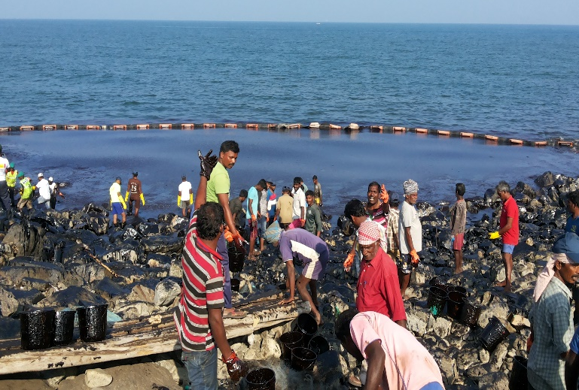
Containment
Encircle a stricken vessel.
Contain spill from a terminal.
Prevent or minimize contact with shoreline.
Increase thickness of oil to facilitate effective skimming operations.
Contain previously stranded oil.
CGPRT(W) : Ensuring Clean Seas and Coasts in Western Region ……

Slide 51
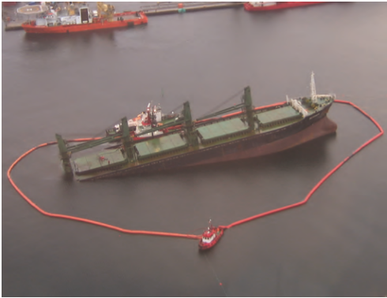
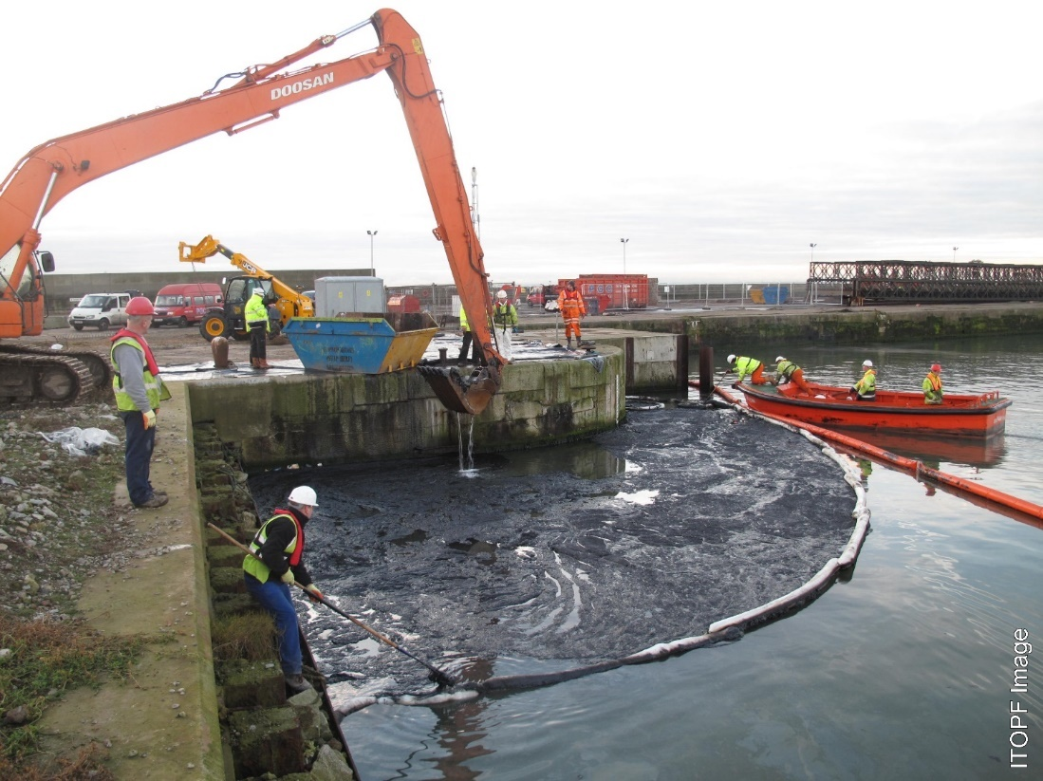
Containment
CGPRT(W) : Ensuring Clean Seas and Coasts in Western Region ……

Slide 52
Redirection
Direct oil away from a sensitive site or shoreline area.
Or direct oil towards a shoreline.
CGPRT(W) : Ensuring Clean Seas and Coasts in Western Region ……

Slide 53
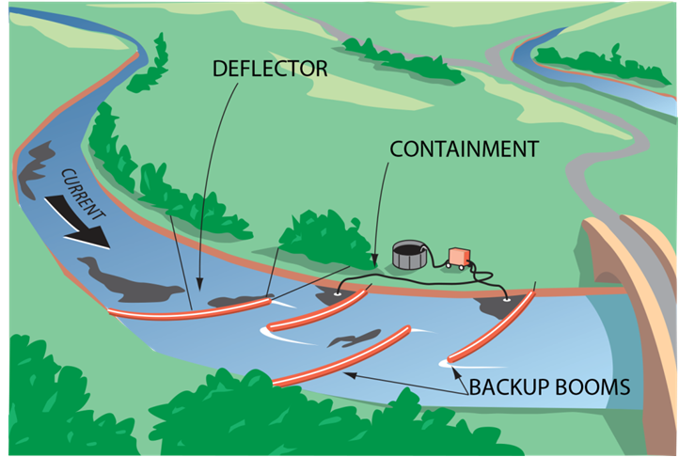
Redirection
CGPRT(W) : Ensuring Clean Seas and Coasts in Western Region ……

Slide 54
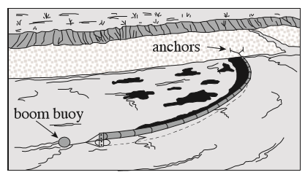
Redirection
CGPRT(W) : Ensuring Clean Seas and Coasts in Western Region ……

Slide 55
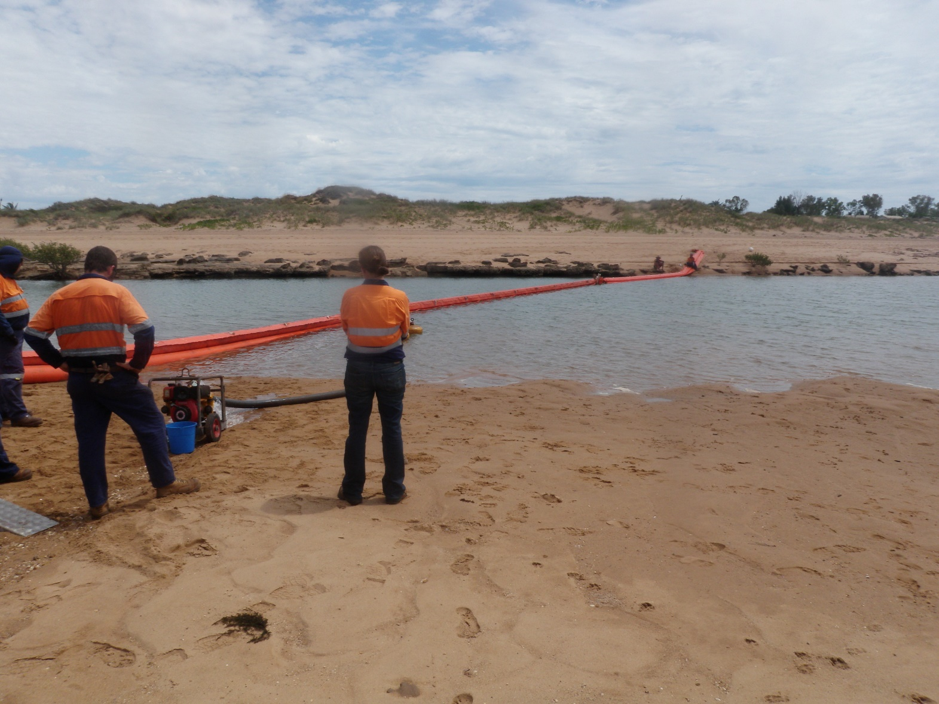
Redirection
CGPRT(W) : Ensuring Clean Seas and Coasts in Western Region ……

Slide 56
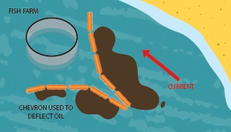
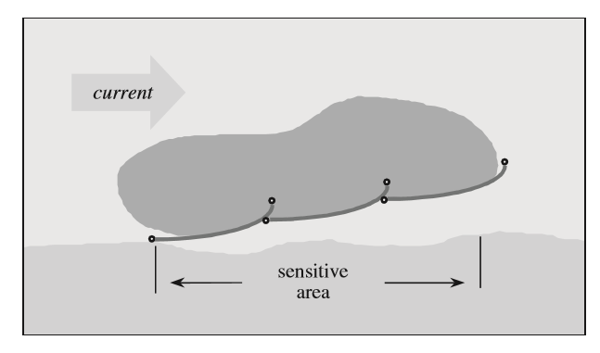
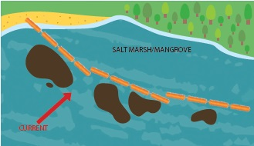
Redirection
CGPRT(W) : Ensuring Clean Seas and Coasts in Western Region ……

Slide 57
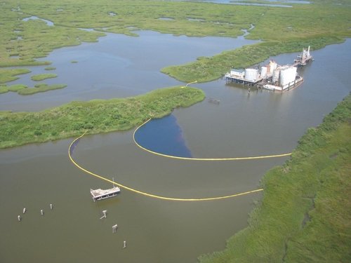

Exclusion
Booming around a sensitivity to exclude oil from sensitivity
Examples: Fish farm, inlets, water intakes, marsh
CGPRT(W) : Ensuring Clean Seas and Coasts in Western Region ……

Slide 58


Exclusion
Source: OSRL
CGPRT(W) : Ensuring Clean Seas and Coasts in Western Region ……

Slide 59


Chevron Booming
Open chevron booming
Closed chevron
booming
CGPRT(W) : Ensuring Clean Seas and Coasts in Western Region ……

Slide 60

Boom Deflectors
Using
boom deflectors
Source: Hansen and Coe
CGPRT(W) : Ensuring Clean Seas and Coasts in Western Region ……

Slide 61
Boom Anchoring
CGPRT(W) : Ensuring Clean Seas and Coasts in Western Region ……

Slide 62
Anchoring Systems
Depends on:
Forces working on the boom
Current direction
Length of boom
Size of vessel
CGPRT(W) : Ensuring Clean Seas and Coasts in Western Region ……

Slide 63
Anchoring
Requires knowledge about:
Seabed
Current direction(s)
Current velocity
Water depth
CGPRT(W) : Ensuring Clean Seas and Coasts in Western Region ……

Slide 64
Anchoring Systems
Knowledge of local seabed condition is essential.
Current in one direction requires anchors on one side - against current.
Current from both sides requires anchors on both sides.
CGPRT(W) : Ensuring Clean Seas and Coasts in Western Region ……

Slide 65
Anchoring Systems
Rope length from anchor to mooring buoy must be 2 times water depth.
Rope length from anchor to anchor buoy must be 2 times water depth.
Anchor size = 20−100 kg and holding power = 30 times its weight.
Anchor chain keeps anchor rod down.
CGPRT(W) : Ensuring Clean Seas and Coasts in Western Region ……

Slide 66

Boom Deployment Angle
Source: OSRL
CGPRT(W) : Ensuring Clean Seas and Coasts in Western Region ……

Slide 67

Common Anchor Types
Anchor Type | Soft Soils | Hard Soils
Danforth LWT | 12.6 | 31.6
STATO NAVMOOR | 27.7 | 25 – 33
Navy Stockless | 3.5 | 11
Anchor holding power
for 45kg (~100 lbs)
Source: U.S. Navy
CGPRT(W) : Ensuring Clean Seas and Coasts in Western Region ……

Slide 68

Typical Anchoring Arrangement
CGPRT(W) : Ensuring Clean Seas and Coasts in Western Region ……

Slide 69

Shoreline Anchoring
CGPRT(W) : Ensuring Clean Seas and Coasts in Western Region ……

Slide 70

Shoreline Anchoring
Use of piles/stakes on shoreline
CGPRT(W) : Ensuring Clean Seas and Coasts in Western Region ……

Slide 71

Anchoring V-Shape Boom
Anchoring
V-shaped boom
in
mid-channel
CGPRT(W) : Ensuring Clean Seas and Coasts in Western Region ……

Slide 72

Anchoring J-Shape Boom
Anchoring
J-shaped boom
CGPRT(W) : Ensuring Clean Seas and Coasts in Western Region ……

Slide 73

Multiple Anchors
Multiple
anchor
deployment
CGPRT(W) : Ensuring Clean Seas and Coasts in Western Region ……

Slide 74

Tidal Entrances
Boom that protects during flood tide
Boom that protects during ebb tide
Position of boom B during flood tide
Source: National Spill Control School
CGPRT(W) : Ensuring Clean Seas and Coasts in Western Region ……

Slide 75

Harbour Flow Patterns − Flood
CGPRT(W) : Ensuring Clean Seas and Coasts in Western Region ……

Slide 76

Harbour Flow Patterns − Flood
CGPRT(W) : Ensuring Clean Seas and Coasts in Western Region ……

Slide 77

Tidal Compensator
CGPRT(W) : Ensuring Clean Seas and Coasts in Western Region ……

Slide 78
Support Equipment
CGPRT(W) : Ensuring Clean Seas and Coasts in Western Region ……

Slide 79
Support Equipment
Boom connectors
Towing bridles and paravanes
Anchor buoys/cans
Boom magnets
Boom lights
CGPRT(W) : Ensuring Clean Seas and Coasts in Western Region ……

Slide 80
Boom Connectors
Various types of connectors for different types, sizes and manufacturers.
Must be compatible to connect, disconnect, add other attachments.
Can have adaptors made but may be difficult to get at the time of spill.
CGPRT(W) : Ensuring Clean Seas and Coasts in Western Region ……

Slide 81
Towing Bridles/Paravanes
For towing boom – provides strong point.
Keeps boom from twisting.
Guides through the water.
Must be compatible with boom connector.
Boom must be towed very slowly, typically less than 1 knot.
CGPRT(W) : Ensuring Clean Seas and Coasts in Western Region ……

Slide 82
Anchor Buoys/Cans
Can be inserted between sections of boom to take the force/stress of the anchor.
Can be fitted with reflective tape or anchor lights.
CGPRT(W) : Ensuring Clean Seas and Coasts in Western Region ……

Slide 83
Boom Magnets
Heavy duty magnets allow boom to be attached to steel hull of vessel or steel wharf.
Allows containment of a section of a vessel or wharf as opposed to complete encirclement.
Creates a good seal to side of vessel – sorbent boom can be placed in any gaps.
Limited in amount of stress that can be on boom without magnet letting go.
Requires approval from vessel master to place on hull.
Safety hazard near pacemakers.
CGPRT(W) : Ensuring Clean Seas and Coasts in Western Region ……

Slide 84
Boom Lights
Boom lights allow boom to be illuminated at night/restricted visibility where boom is a hazard to navigation.
Solar lights.
CGPRT(W) : Ensuring Clean Seas and Coasts in Western Region ……

Slide 85


Boom Vane
Can be deployed from shore or a vessel to create a single vessel sweep.
Source: ORC AB
CGPRT(W) : Ensuring Clean Seas and Coasts in Western Region ……

Slide 86

Boom Storage
Boom can be stored on a reel, in containers, in trailers.
Stored clean and dry, protected from elements, sunlight and pests (rodents, racoons, etc.).
Stored in a ready state.
Source: CEDRE
CGPRT(W) : Ensuring Clean Seas and Coasts in Western Region ……

Slide 87
Boom Cleaning
Boom that has been used should be rinsed with fresh water and stored dry.
Boom that has been oiled should be decontaminated properly by washing manually or in a boom washing machine.
Boom should be inspected for damage before being stored.
CGPRT(W) : Ensuring Clean Seas and Coasts in Western Region ……

Slide 88
Any questions?
CGPRT(W) : Ensuring Clean Seas and Coasts in Western Region ……

